Slide 1
C++ Design Pattern
Soumil Shah &Nery Ruiz
Bachelor in Electronic Engineering
Master in Electrical Engineering
Master in Computer Engineering
Full stack Python Developer

Slide 2
What is Design Pattern ?

Slide 3
What is Design Pattern ?
Design patterns are used to represent some of the best practices adapted by experienced object-oriented software developers. A design pattern systematically names, motivates, and explains a general design that addresses a recurring design problem in object-oriented systems. It describes the problem, the solution, when to apply the solution, and its consequences. It also gives implementation hints and example [1]

Slide 4
Why do we need Design Pattern ?
Design patterns have two major benefits. First, they provide you with a way to solve issues related to software development using a proven solution. The solution facilitates the development of highly cohesive modules with minimal coupling. ... Second, design patterns make communication between designers more efficient.

Slide 5
How we implemented Design Pattern
We Implemented Singleton Design Pattern , Bridge Design Pattern and Façade Design Pattern

Slide 6
Our Architecture

Slide 7
Singleton Design Pattern
Advantages
Creates only one instance of class
Creational Design Pattern

Slide 8
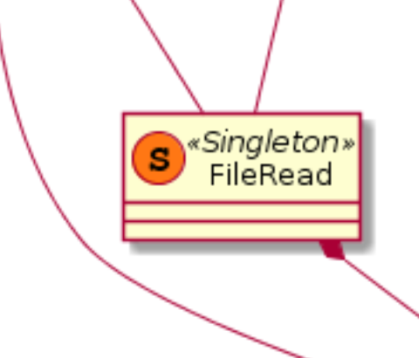
Singleton Design Pattern
We should not create multiple Instances of the class File Read

Slide 9
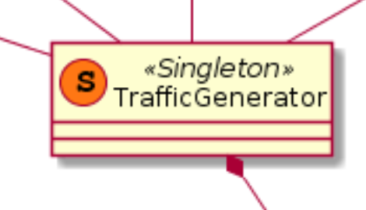
Singleton Design Pattern Traffic Generator

Slide 10
Bridge Design Pattern
The bridge pattern is a structural design pattern.
In the bridge pattern, we separate an abstraction and its implementation and develop separate inheritance structures for both the abstraction and the implementer. The abstraction is an interface or abstract class, and the implementer is likewise
Lets us see a use case

Slide 11
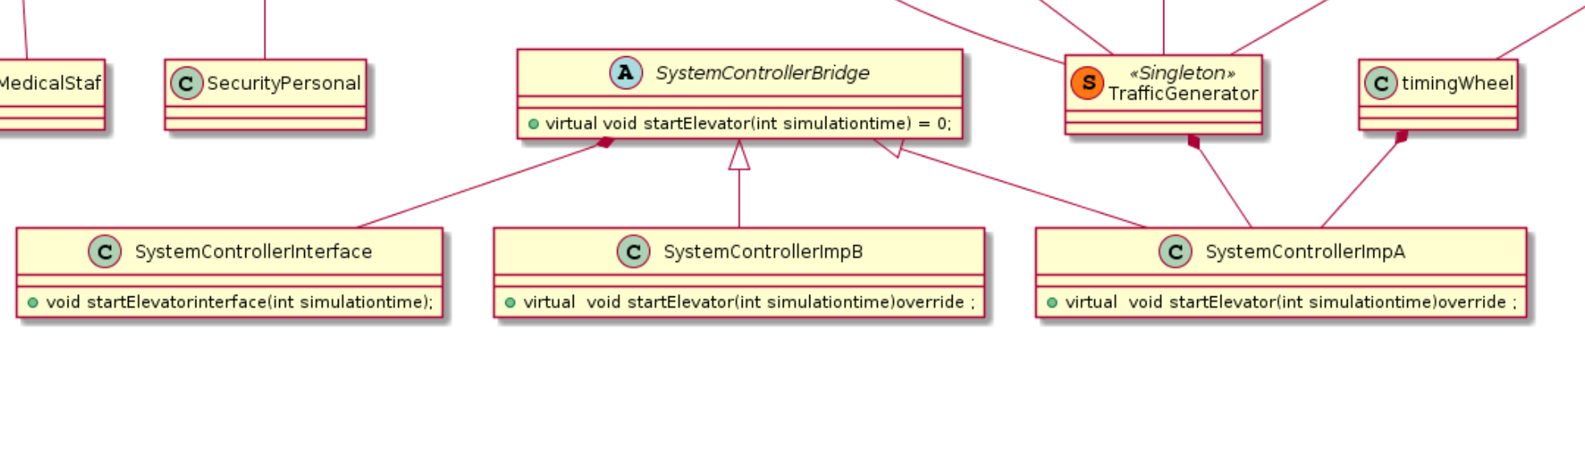
Bridge Design Pattern
Notes:
Explanation

Slide 12
Advantages of using Bridge Design Pattern for System Controller
Can easily add a more improved and efficient code in future
Its open for modification and extension
Other class are not affected

Slide 13
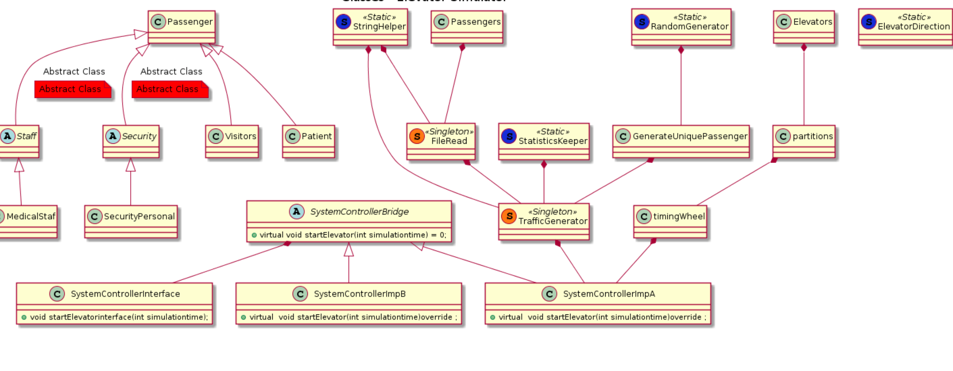
Façade Design Pattern

Slide 14
Advantage of using façade Design Pattern
Facade Pattern defines a higher-level interface that makes the subsystem easier to use.
A facade can make a software library easier to use, understand and test,

Slide 15

Thanks you

Slide 16
References
1 https://www.geeksforgeeks.org/software-design-patterns/

